Slide 1
SIMPLE-fying Middlebox Policy Enforcement Using SDN
Presented By:
Mrinal Aich
M.Tech, Dept. Of Computer Science
Indian Institute of Technology, Hyderabad

Slide 2
Stages of Flow Installations
I. On Startup: Flow rules specific to the Service Chain.
II. After Connection Establishment: Specific to the connection.

Slide 3
Scenario - 1

Slide 4
On Startup:
1. Install Mandatory flow rules specific to the Service Chain.
S1 -> MB1 -> S1 -> S2 -> S3 -> MB2 -> S3 -> S2 -> S1 -> MB3 -> S1
e.g.
# Switch-S1
MATCH |  | ACTION
In-Port | Vlan-Id | Out-Port | Vlan-Id
4 | VLAN_ID_MIDDLEBOX_MB1 (1) | 2 | VLAN_ID_S1_S3_TUNNEL_VIA_S2 (4)
2 | VLAN_ID_S1_S3_TUNNEL_VIA_S2 (4) | 5 | VLAN_ID_MIDDLEBOX_MB3 (3)
# Switch-S2
MATCH |  | ACTION
In-Port | Vlan-Id | Out-Port | Vlan-Id
1 | VLAN_ID_S1_S3_TUNNEL_VIA_S2 (4) | 2 | VLAN_ID_S1_S3_TUNNEL_VIA_S2 (4)
2 | VLAN_ID_S1_S3_TUNNEL_VIA_S2 (4) | 1 | VLAN_ID_S1_S3_TUNNEL_VIA_S2 (4)

Slide 5
After Connection Creation:
Cases to be Considered:
1. Ingress/Egress Switches.
e.g. a. Packets destined to the connected hosts should be delivered.
b. Forwarding the packet to the switch of the first segment.
2. Service Chain Initiator/Terminating Switch
a. Receiving: On receiving a packet for service chaining, initaite Service Chain.
b. Delivery: On successful Service Chaining, the packet should be forwarded to its destination.
3. Intermediate Switches
e.g. a. Packets to be forwarded to the switch of the first segment.

Slide 6
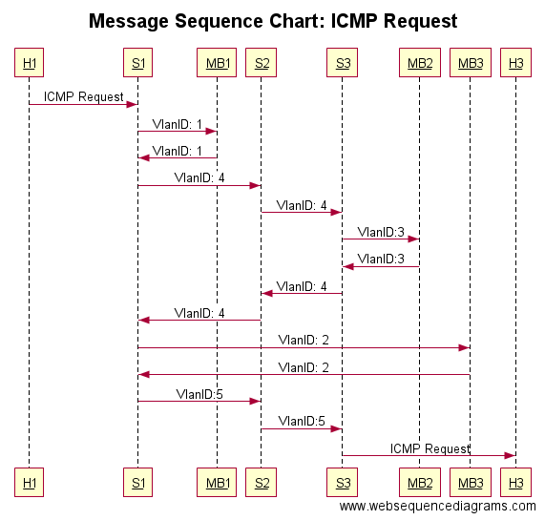

Slide 7
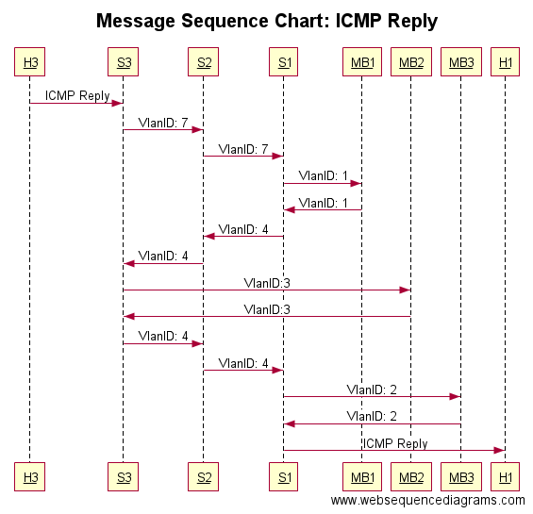

Slide 8
Demo – Scenario 1

Slide 9
Scenario - 2

Slide 10
Demo – Scenario 2

Slide 11
Questions ???

